Slide 1



Electric Propellant Feed System
Johnny Froehlich, Jonathan Talik, James Luce, Rawand Rasheed, Mimi Shang, Jordan Roland
Affiliations: ¹Portland State Aerospace Society, ²Maseeh College of Engineering and Computer Science Portland, OR, 97201, United States

Slide 2
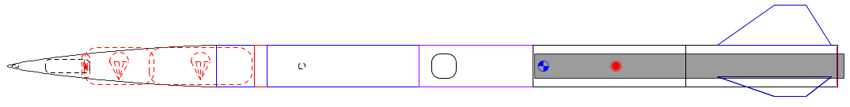

The problem:
Portland State Aerospace Society (PSAS) wants its rockets to go higher.
The rocket equation dominates:
Δv = change in velocity
V_{e} = exhaust velocity
m_{o} = mass of rocket + propellant
m_{f} = mass of rocket

Slide 3
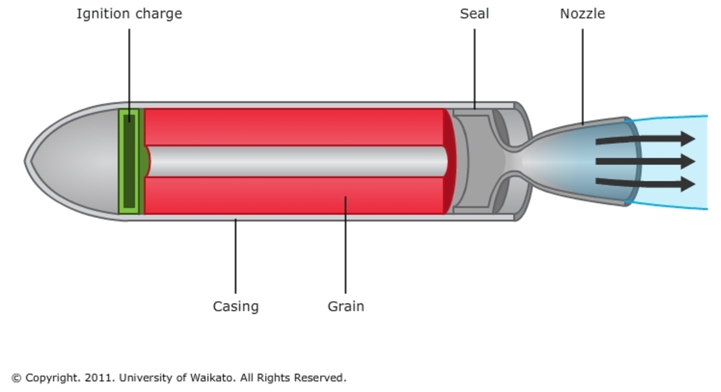
Past approach
Most small rockets use solid propellant.
Solid propellant is easy but inefficient.
Can’t throttle solid rockets= can’t insert into orbit.

Slide 4
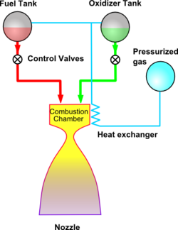
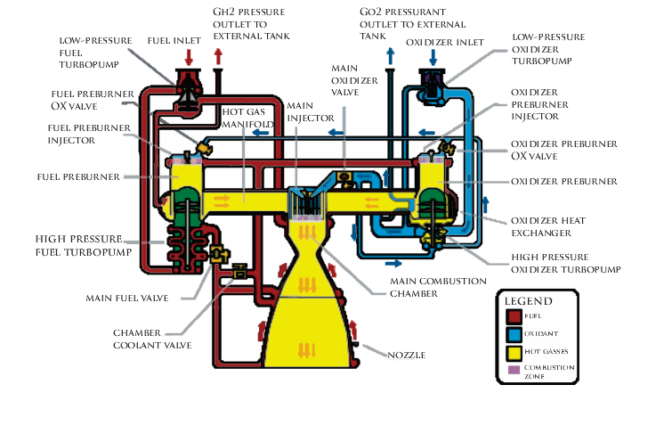
Liquid propellant
Liquid propellant gives more Δv for its mass.
Common approaches:
Pressure fed: too heavy
Turbopump: too complex
Images from wikipedia

Slide 5
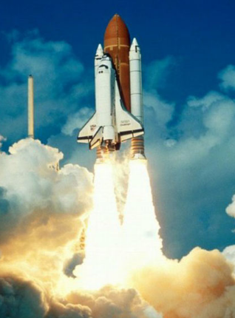
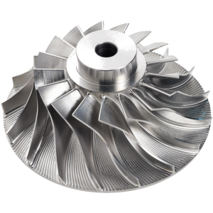
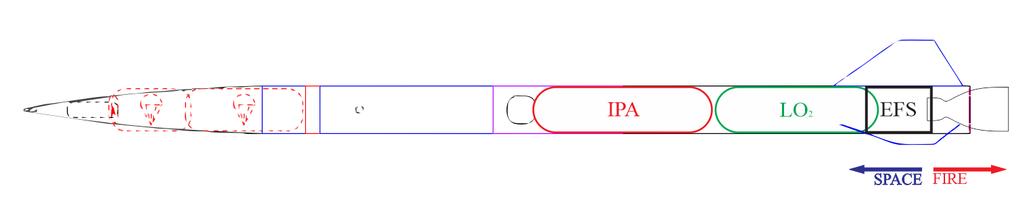
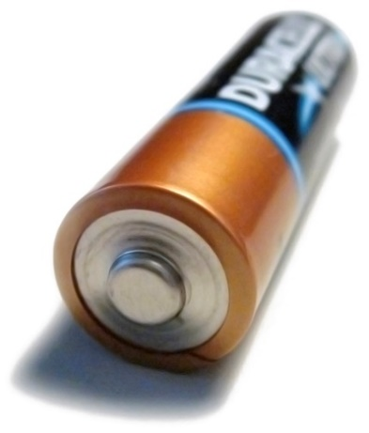
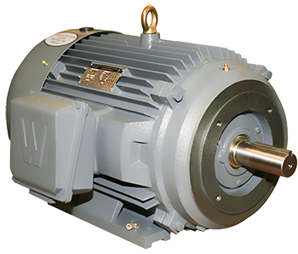
Electric motors: a new approach?
Remove the turbine from a turbopump = just a pump.
Battery energy density has been rising.
This is a new space in rocketry.
https://en.wikipedia.org/
http://www.blue-sky-technologies.com/impeller-seal-repair/
http://www.worldwideelectric.net/

